Slide 1
Saleslogix
Technical Session

Slide 2
Get More Done Through UI Automation
Presented by Matt Buechel – Automation Team Manager

Slide 3
Session Agenda
UI Automation with Selenium IDE
Load/Performance testing with JMeter

Slide 4
What is Selenium?
Selenium is an open-source tool for browser automation
Selenium IDE
Firefox add-on for simple record and playback
Create quick scripts without any coding
Selenium WebDriver
Selenium API used in common IDEs (Eclipse, Visual Studio, etc.)
Robust, browser-based regression automation

Slide 5
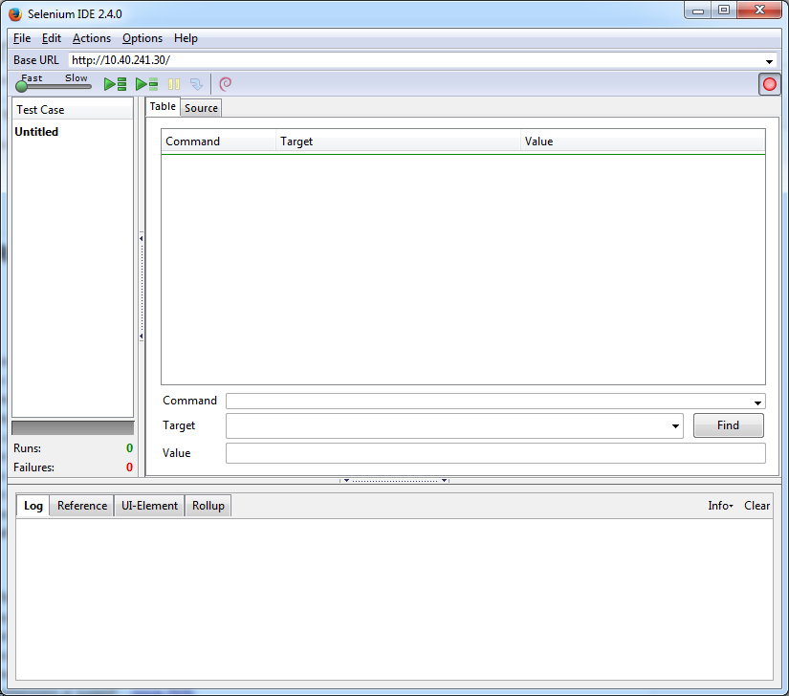
Selenium IDE
Firefox Setup
Install Firebug, FirePath, and Selenium IDE
Launch Selenium IDE in Firefox
Select: Web Developer -> Selenium IDE
Or simply type CRTL + ALT + s
Selenium IDE opens and starts
recording by default

Slide 6
Selenium IDE
Example: Your first test
Perform the following actions with Selenium IDE recording
Navigate to the Saleslogix login page
Enter ‘lee’ in the user name field
Click the logon button
Click the Accounts nav button
Click the ‘Abbott Ltd.’ link/record
Click the log off button
Stop the recording in Selenium IDE

Slide 7
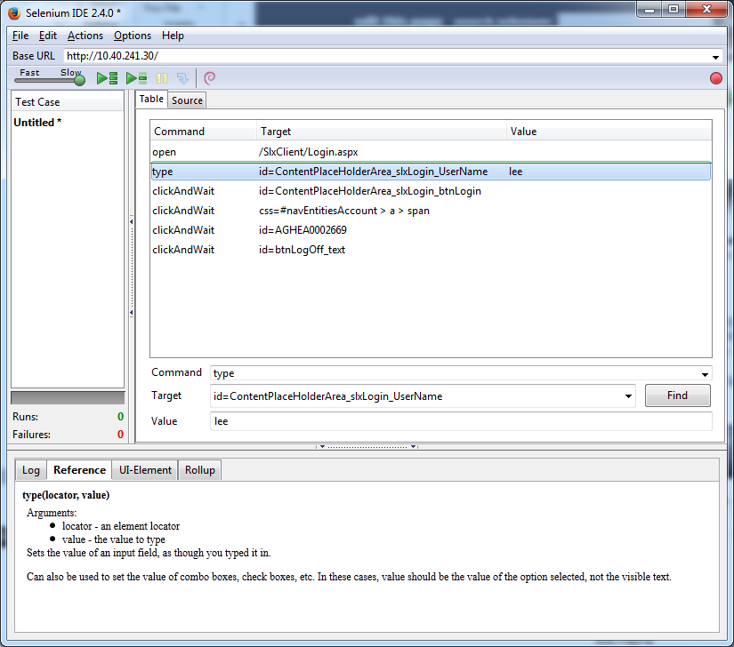
Selenium IDE
You should have a test similar to:
Each command line contain 3 fields
Command: List of built-in commands
Target: The element to work with
Value: The value to use (optional)

Slide 8
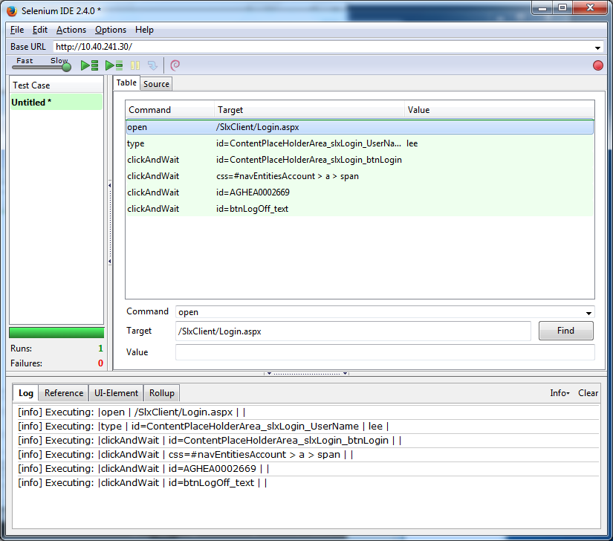
Selenium IDE
Play back your recorded test
Move the slider to “Slow”
Click the “Play current test case” button
You’ve created your first test!
But it’s pretty simple…

Slide 9
Selenium IDE
Using XPath values to make test more dynamic
XPath is a simple query language for selecting nodes from an XML document
XPath allows you to search and find web page elements based on the elements properties
You can use XPath values to create verification points in your test
Using FirePath to get and test XPath values
In Firefox, open Firebug and select the FirePath tab
Click the inspector button and select an item in the page
The field is highlighted in the UI and the XPath is listed

Slide 10
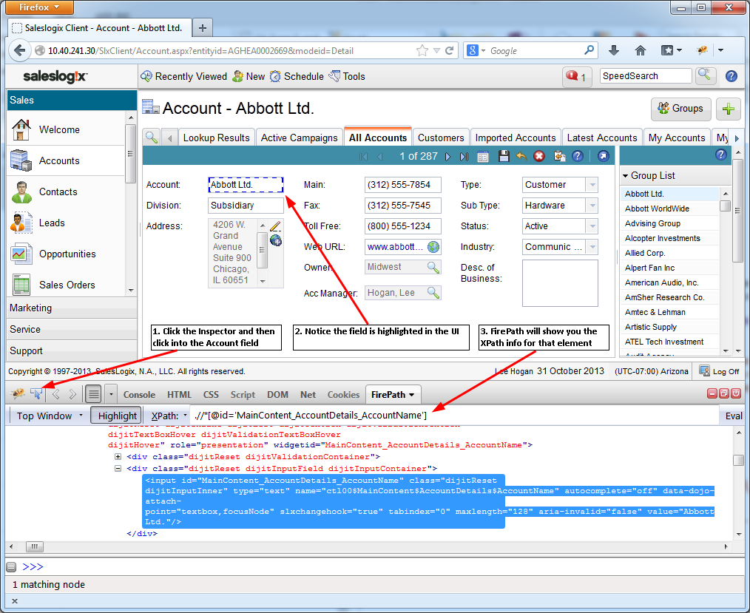
Selenium IDE

Slide 11
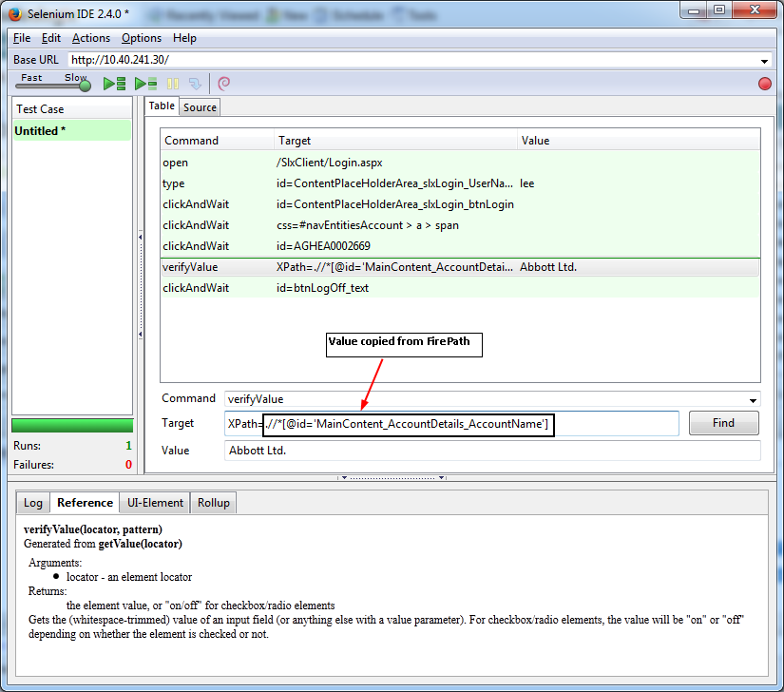
Selenium IDE
Add a verification point to your test
In SLX navigate back to the Account Detail view
RMB and select “Insert New Command”
In the Command dropdown select “verifyValue”
Enter “Xpath=“ in the Target field
Copy the XPath from FirePath to the Target field
Enter “Abbott Ltd” in the Value field

Slide 12
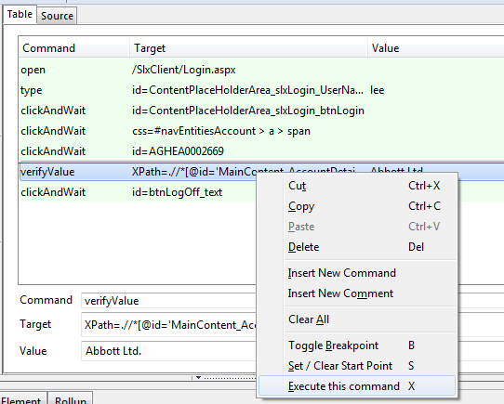
Selenium IDE
Test out your new command
RMB on the verifyValue command and execute
The command line should turn green for
a successful verification

Slide 13
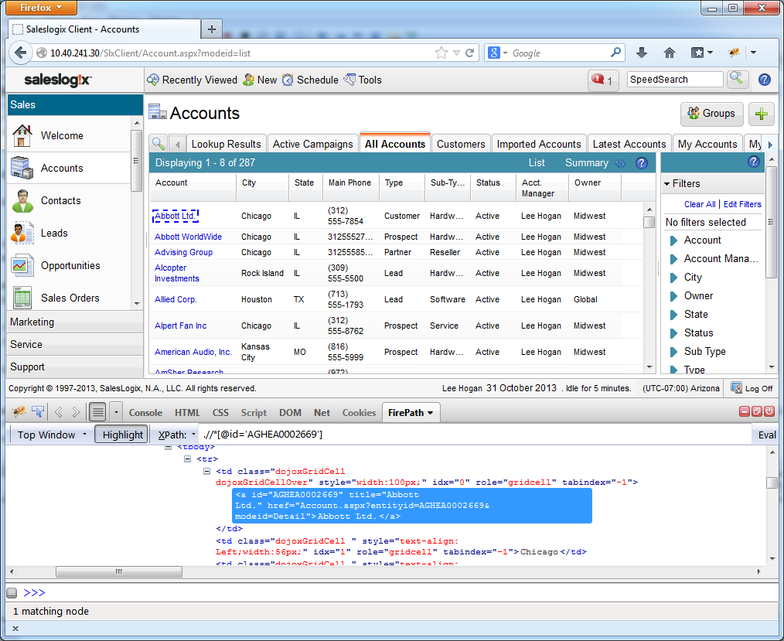
Using XPath to search for elements
Example: Modify existing test to use XPath to click the Account record
Use FirePath to highlight “Abbott Ltd.”
Notice the full list of properties highlighted
Use the “title” property to identify
Find a top-level element for XPath to search under
In this case we’ll use: div class="dojoxGridContent"
Change the XPath to what’s on the following slide

Slide 14
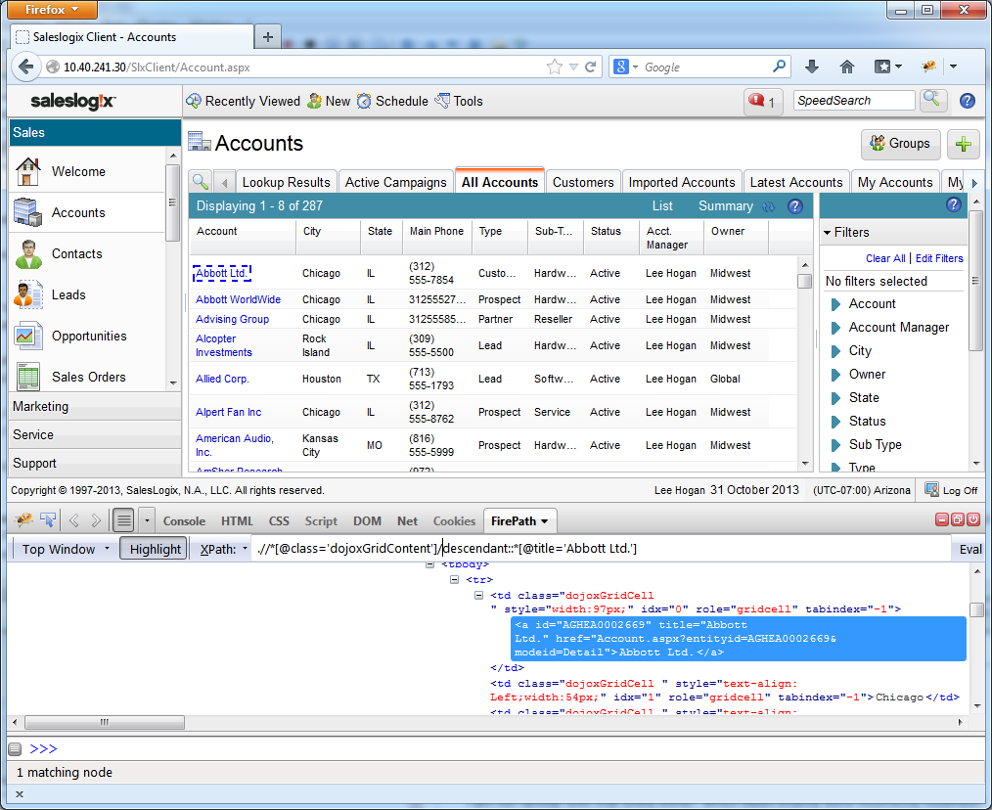
Using XPath to search for elements
Change XPath to: .//*[@class='dojoxGridContent']/descendant::*[@title='Abbott Ltd.']

Slide 15
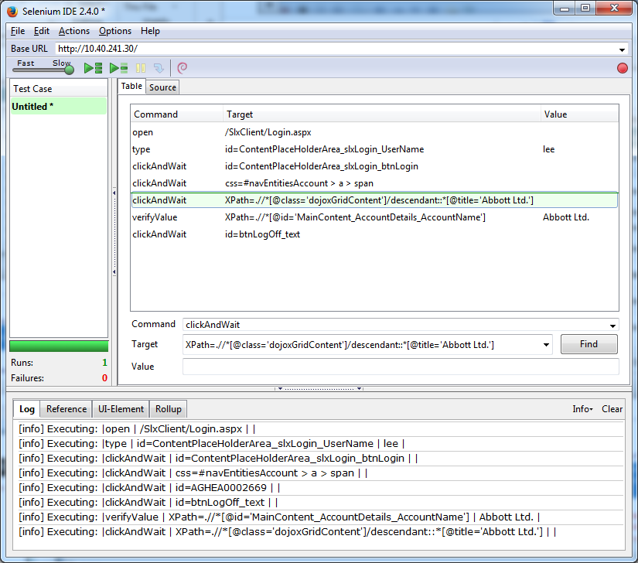
Using XPath to search for elements
Update the command in IDE and execute
Selenium IDE should find the element
and click it

Slide 16
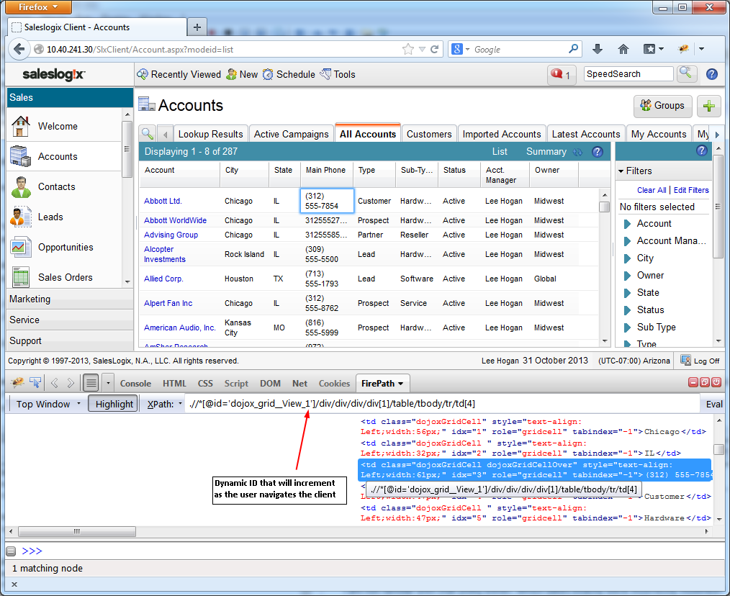
Using XPath with Dynamic IDs
Some elements in SLX will have a dynamic ID
Use FirePath to select a field on a grid
Notice the “_1” appended on the id
That usually means the id will increment every time it’s navigated to
This can cause playback to be error prone
Change the XPath to something like below
.//*[@class='dojoxGridContent']/descendant::*[text() = '(312) 555-7854']

Slide 17
Saving, Editing, and Exporting IDE Tests
Saving and editing your tests
Selenium IDE tests are saved as HTML files
These files can be opened in a text editor and edited. This makes bulk updates easier
Exporting Selenium IDE Tests
In the Selenium IDE select File -> Export Test Case As…
You can then choose a number of different output choices
This can be helpful if you want to import your tests into Selenium WebDriver

Slide 18
Selenium WebDriver
See the WebDriver project documentation in the GitHub repository for instructions on how to setup and use the WebDriver documentation

Slide 19
Questions?
Any questions on Selenium IDE?

Slide 20
Performance & Load Testing with JMeter
What is JMeter?
JMeter is an open-source Java desktop application designed to load test functional behavior and measure performance
What does JMeter do?
Has the ability to load and performance test many different server/protocol types:
Web - HTTP, HTTPS
SOAP
FTP
Database via JDBC
LDAP
Message-oriented middleware (MOM) via JMS
Mail - SMTP(S), POP3(S) and IMAP(S)
Native commands or shell scripts
TCP

Slide 21
Performance & Load Testing with JMeter
Where to get JMeter?
Can be downloaded from here: http://jmeter.apache.org/download_jmeter.cgi
You’ll also need the Java JDK here: http://www.oracle.com/technetwork/java/javase/downloads/index.html
JMeter Setup
Download and extract to the local disk
Once extracted, copy the extracted folder somewhere easy to locate. I usually just do the root of C:\
In the JMeter folder, find the JMeter.bat file and open it in a text editor
Update the HEAP setting to the amount of memory you want to allow JMeter to use. The more the better.
set HEAP=-Xms1024m -Xmx1024m
Double click the JMeter.bat to launch JMeter

Slide 22
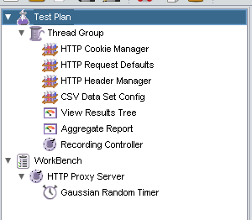
Performance & Load Testing with JMeter
Setting up your Test Plan
RMB on “Test Plan” and add a Thread Group
RMB -> Add -> Threads (Users) - > Thread Group
RMB on the Thread Group created above and add the following items
Config Element -> HTTP Cookie Manager
Config Element -> HTTP Request Defaults
Config Element -> HTTP Header Manager
Config Element -> CSV Data Set Config
Listener -> View Results Tree
Listener -> Aggregate Report
Logic Controller -> Recording Controller
RMB on WorkBench and add the following
Non-Test Elements -> HTTP Proxy Server
RMB on the HTTP Proxy Server and add
Timer -> Gaussian Random Timer

Slide 23
Performance & Load Testing with JMeter
Configuring the HTTP Proxy Server to Record HTTP Traffic
Click on the HTTP Proxy Server to display its settings
Change the port to 8088
Click the Add suggested Excludes button
Set the Target Controller to your Controller
Test Plan -> Thread Group -> Recording Controller
Set the Gaussian Random Timer value
This records the Think Time when recording your scenario, so you can mimic a real user
Set the Constant Delay Offset to: ${T}
Set the Deviation to the amount of deviation from the recorded think times you’d like to have during playback
Configure your browser (Firefox) to use the JMeter Proxy
In Firefox, open the Options dialog and click the Network tab
Click the Settings button
Choose the “Manual proxy configuration” radio button
Enter “localhost” in the HTTP Proxy field
Change the port to 8088
Check the “Use for all protocols” checkbox
Click OK

Slide 24
Performance & Load Testing with JMeter
Recording a scenario
In the HTTP Proxy Server page, click the “Start” button
Open Firefox and navigate to a Saleslogix website
Log into Saleslogix
Navigate to a Contact detail view
Add a new Note
Log Off
Once finished, click the “Stop” button on the HTTP Proxy Server page
You should now notice that your “Recording Controller” node has child items
If you expand the “Recording Controller” you’ll see all the request that were just recorded
Remove and “/safebrowsing…” requests

Slide 25
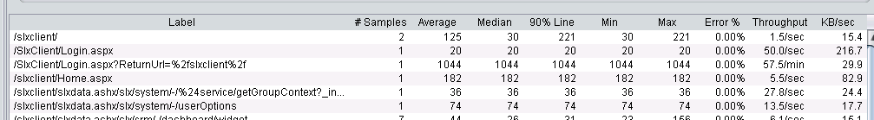
Performance & Load Testing with JMeter
Playing back your scenario
Save your Test Plan if you haven’t already
Click the Thread Group node and set the number of threads (users) to 1
RMB on the “CSV Data Set Config” and disable for now
Click the “View Results Tree” node so you can see the requests as they’re run
Click the “Start no pauses” button
Once the playback has finished, you can click the “Aggregate Report” node to see a summary of the results

Slide 26


Performance & Load Testing with JMeter
Editing your scenario
Under the Recording Controller, click the “/SlxClient/Login.aspx?ReturnUrl=%2fslxclient%2f” request
View the Parameters tab of the request and you should notice UserName and Password parameters with the recorded values.
You can set the value of these parameters (and any other request parameter) to pull from a CSV file instead of using the recorded values.
So, if you have a CSV file full of valid User Names and Passwords you could have Jmeter use those values instead. You’d simply:
Enable the “CSV Data Set Config” to point to your CSV file
Use the column header name of the CSV file to tell the request to pull the data from the column
The format need to be ${columnheader}

Slide 27
Performance & Load Testing with JMeter
Editing your scenario (cont.)
The JMeter Test Plan is saved as an JMX file that can be edited in any text editor. This allows you to easily make bulk changes without having to update every individual request in the UI.
Using the previous example, you’d probably want to replace the recorded USERID with a value from a CSV file that matches the corresponding User Name.
This could be done by opening the JMX file in a text editor and doing a search for recorded USERID and replacing it with the CSV value (I.E. ${USERID})

Slide 28
Performance & Load Testing with JMeter
Running a Load Test
Once you’ve gotten your scenario setup the way you’d like, you’re ready to run a multi-user test
Simply click on your Thread Group and set these values
Number of Threads (users): This is the number of users you want the test to ramp up to
Ramp-Up period (in seconds): This is how long you want it to take for all users to be logged in
Loop Count: How many iterations of your test/scenario should each virtual user run
Click the Clear All button to clear results from any previous runs
Click on the Aggregate Report and then click the Start button
The users will start logging on and you’ll be able to see the results in real time

Slide 29
Performance & Load Testing with JMeter
Misc.
Some load testing tools have the ability to monitor remote servers (I.E. a web or SQL server), JMeter doesn’t have that ability. To get around that, you can simply use the built-in Windows Performance monitors on your servers to track any counters you may want.

Slide 30
Resources
You can get all the docs and projects from this presentation here:
https://github.com/mbuechel/PartnerConf2013

Slide 31
Questions?
Any questions on UI automation or load testing?

